Slide 1
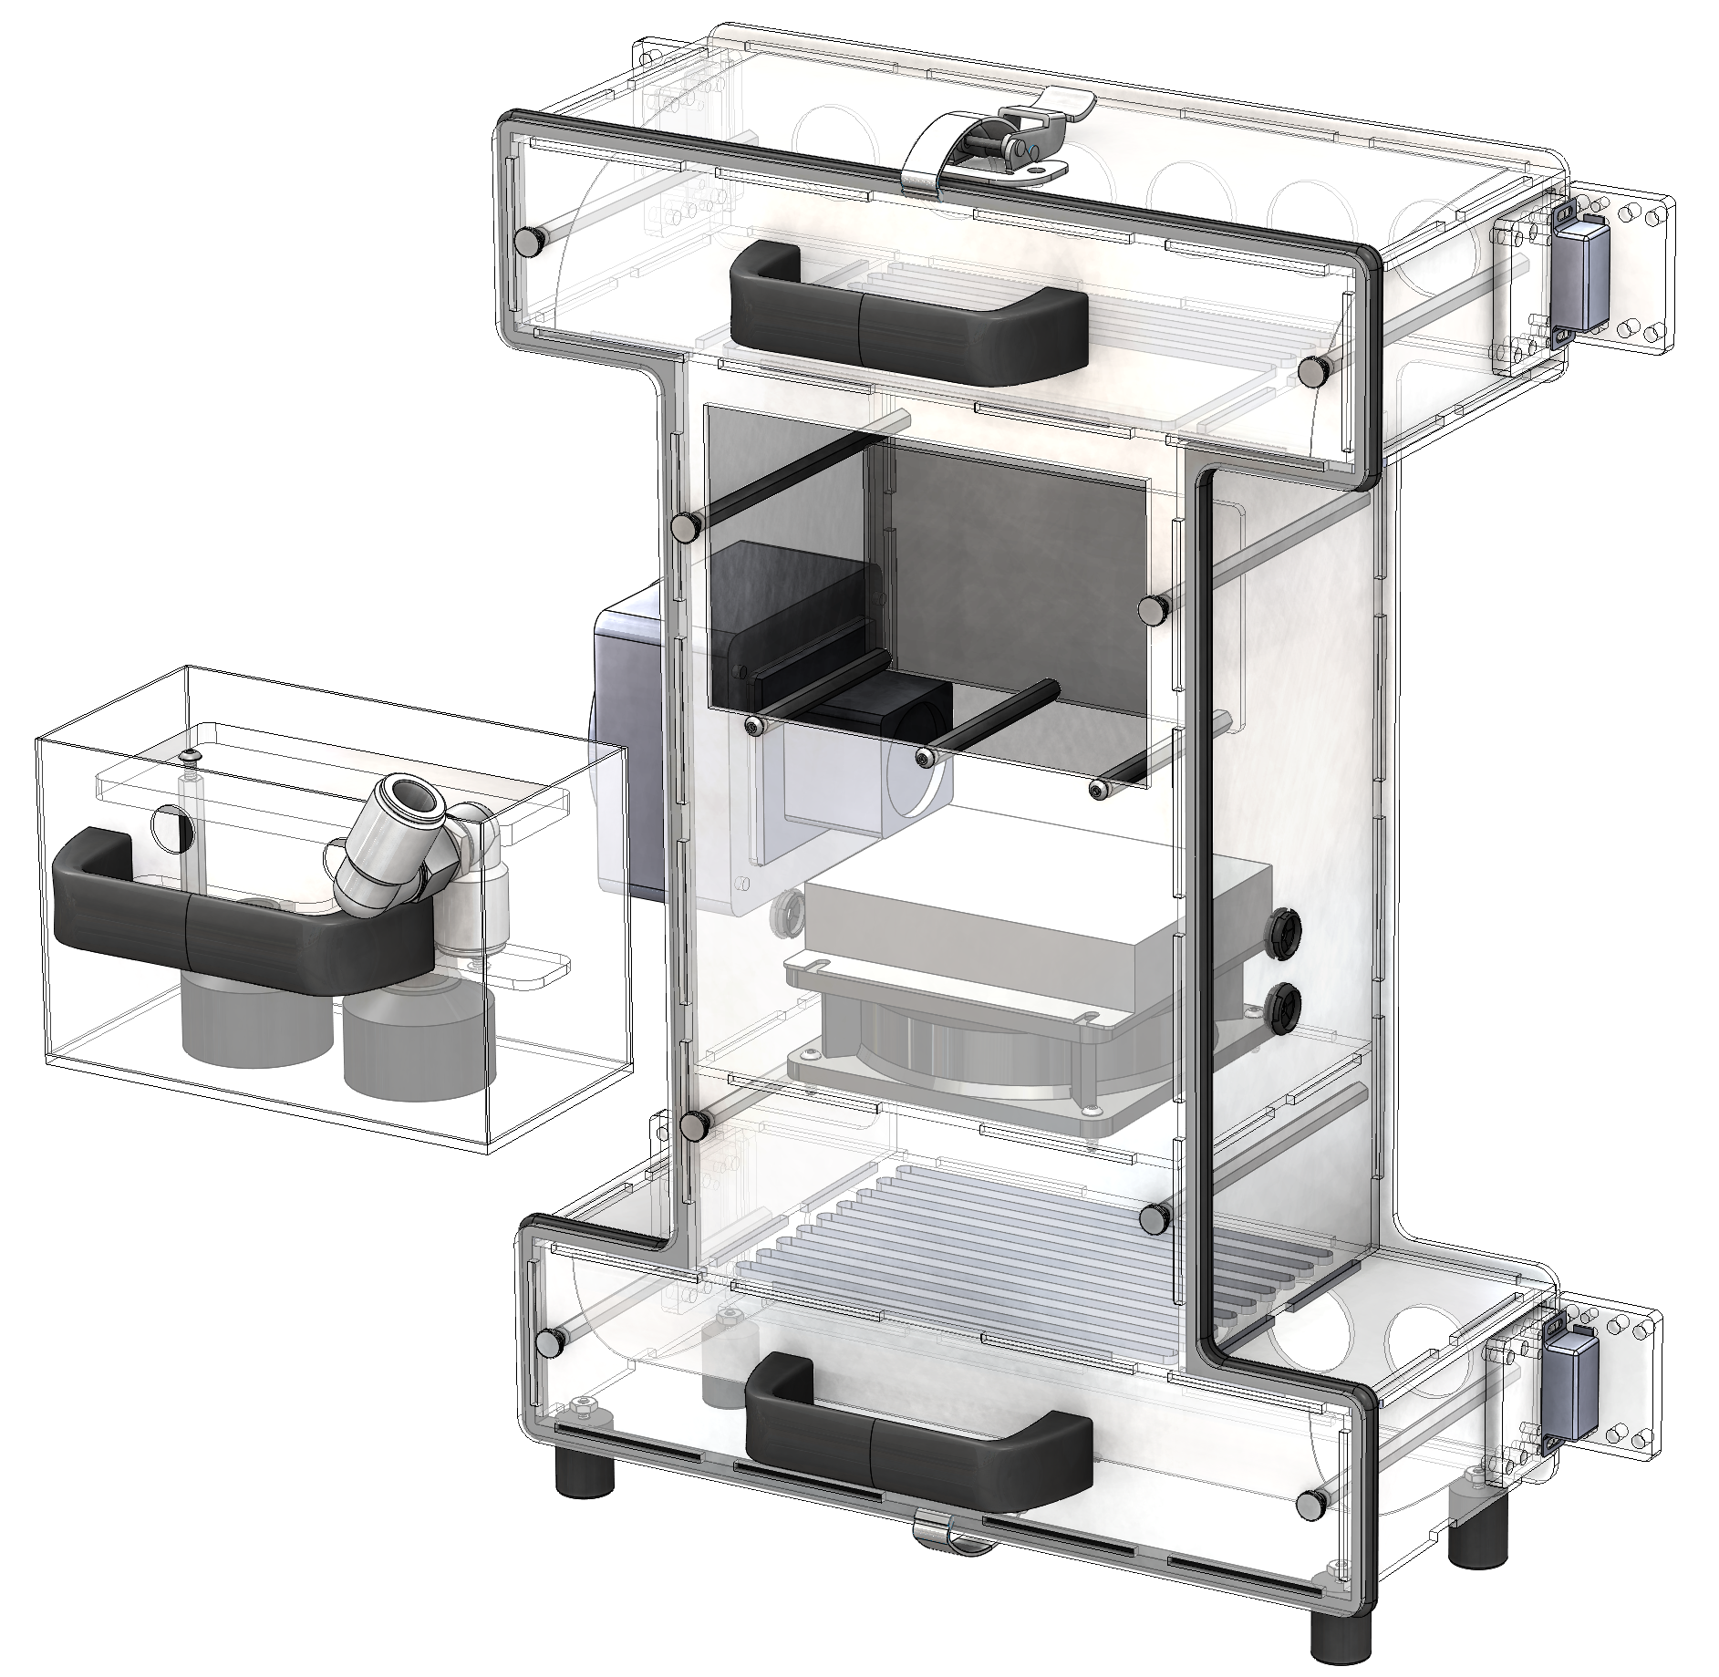
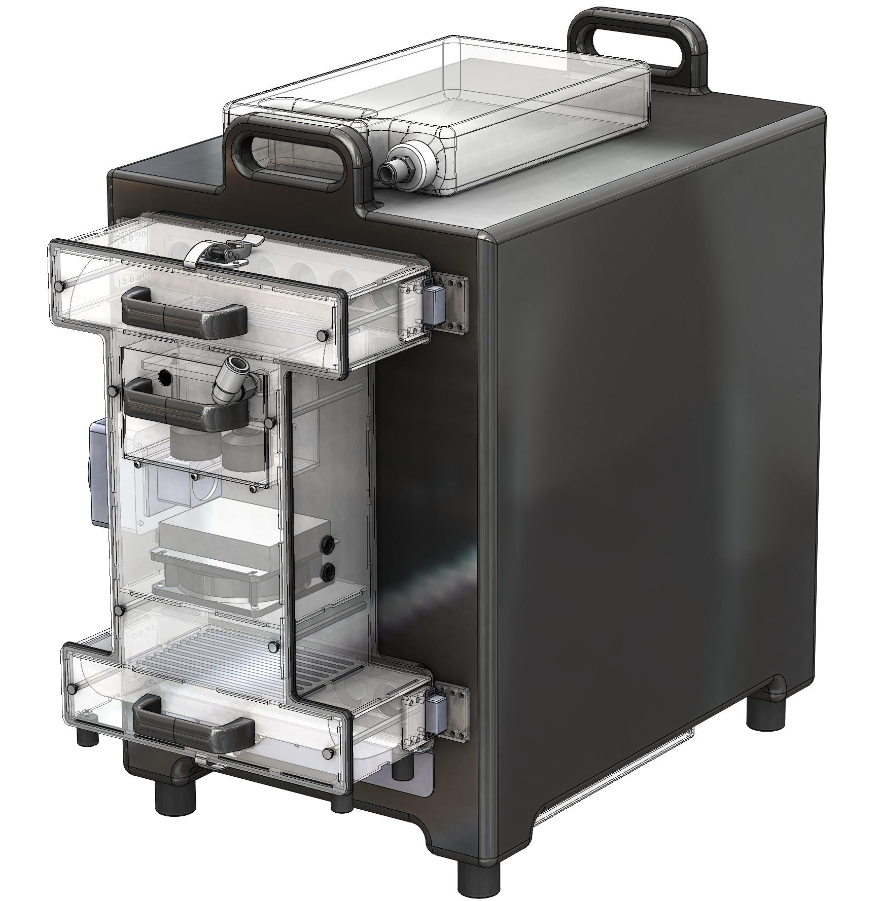
Fermentabot
Small-scale, digitally controlled fermentation for recycling of food waste

Slide 2
Fermentabot Project Overview
Mechanical Specifications and Requirements
Housing and storage
Insulated food storage box and perforated food pans/cotton cloth
An “Environmental Chamber”
A device that can be attached/removed from the catering box and contains all the mechanical actuators such as heaters and fans.
Air circulation heating/cooling system
12V Peltier Cooler
12V heating element
12V equipment-cooling fan
Humidification system
External humidification cartridge
Miniature ultrasonic fogging technology
Control System
Humidity and temperature control

Slide 3
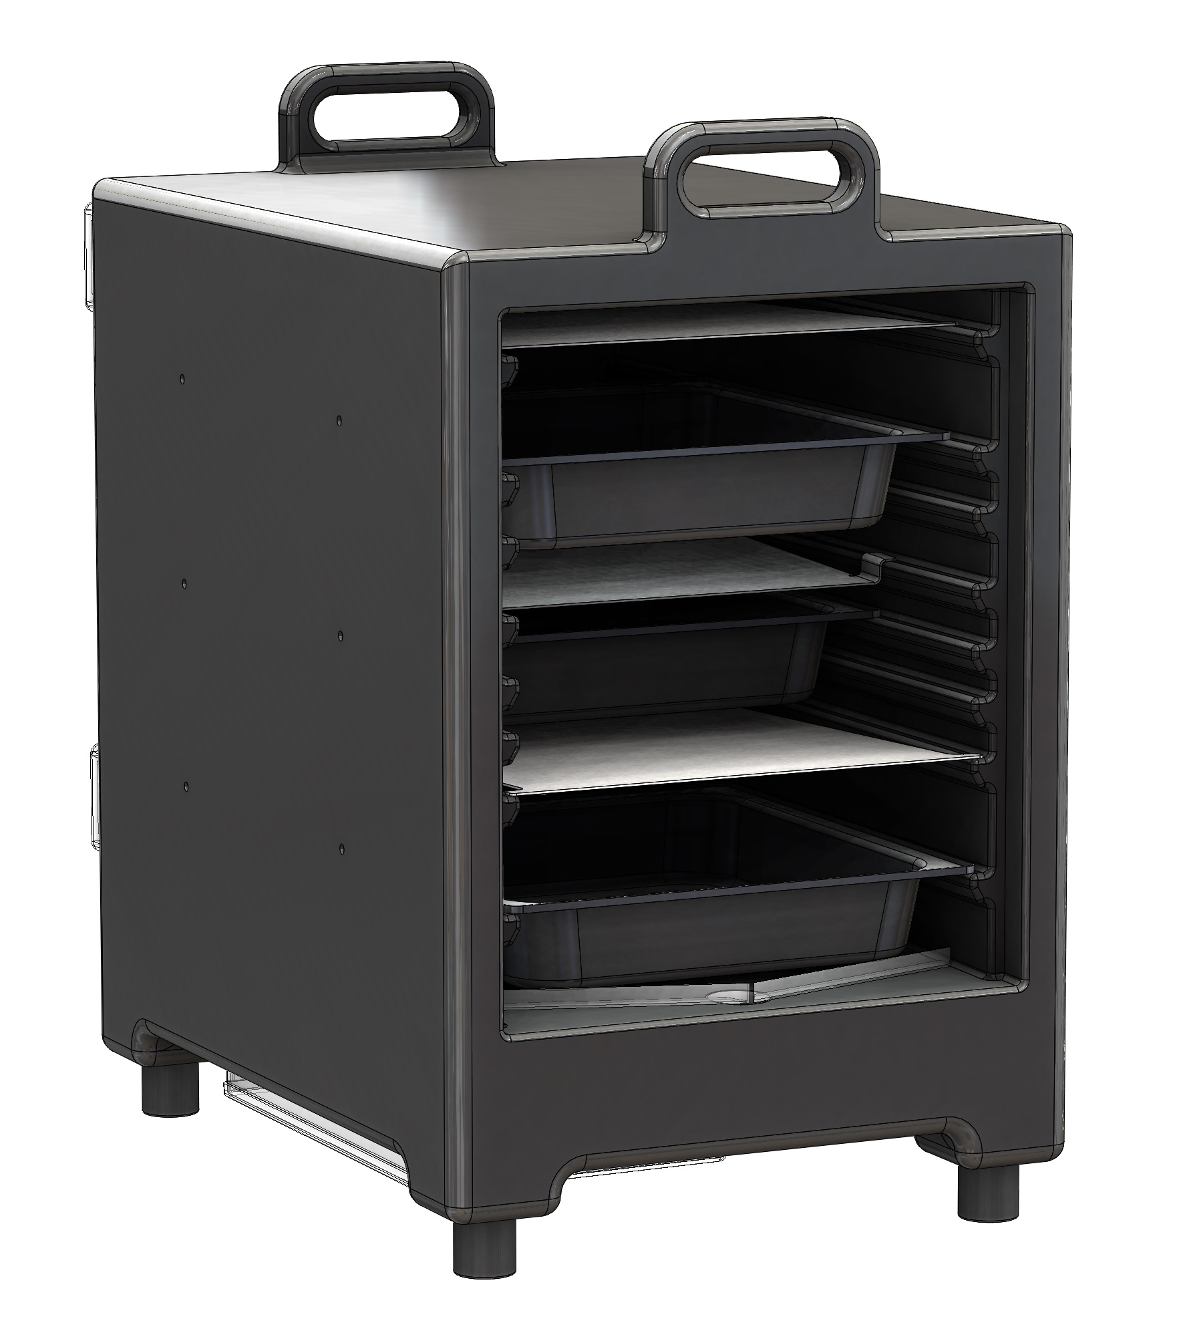
Renderings details of improvements, multiple views
Design Progress
Internal slanted covers act as “condensation guards” to keep condensation from gatherin on koji cloths
Design of Environmental Chamber based on available materials at OpenAg (mostly acrylic sheets) and fabrication capabilities (laser cutter)
Off-the-shelf components used whenever possible
Asdads
asdad

Slide 4
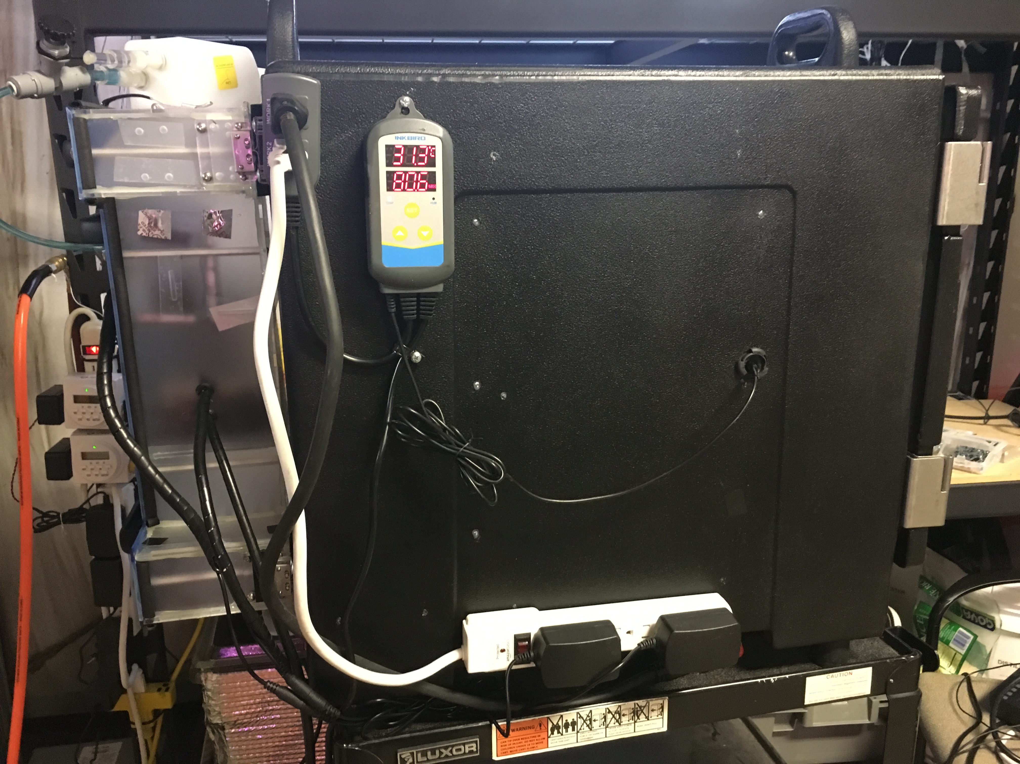
Photos of current prototype, multiple views
Design Details
Environmental Chamber
Piezo Cooler
Fan
Heater
Humidifiers
Temp/Humidity Control System

Slide 5
Pic of our first batch of koji
Testing Results
Koji grown successfully at 32°C and 80% RH

Slide 6
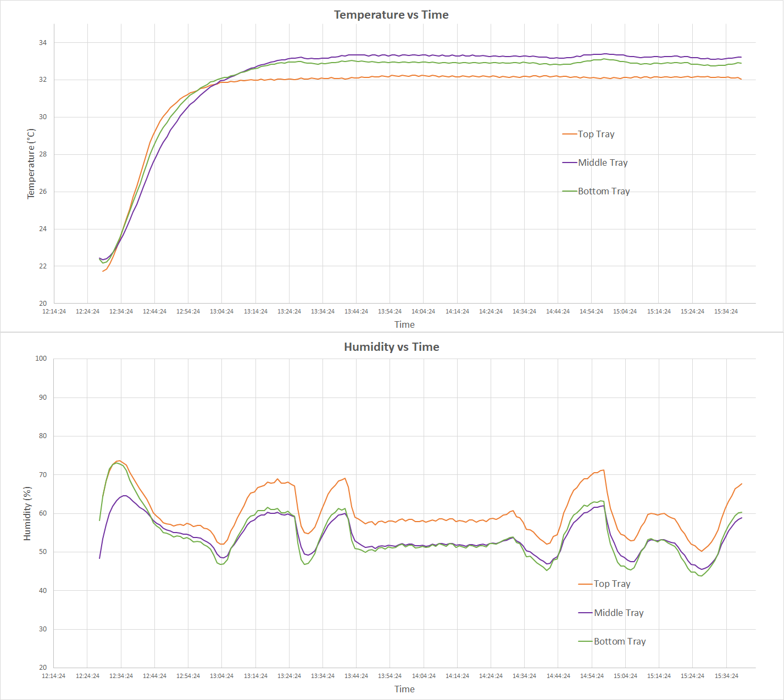
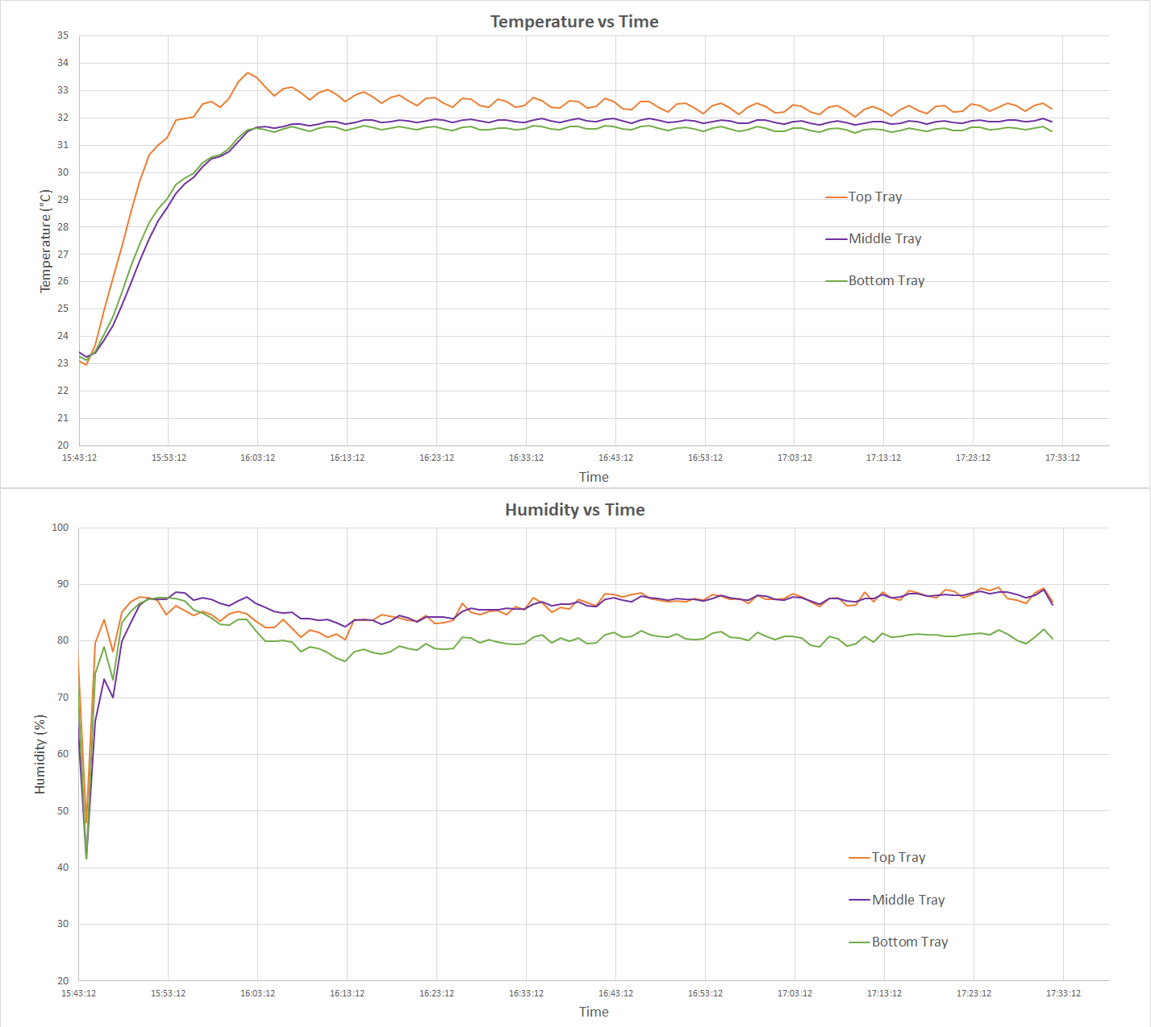
Testing Results
Ds
Dsf
Adasd
Asdads
asdad

Slide 7
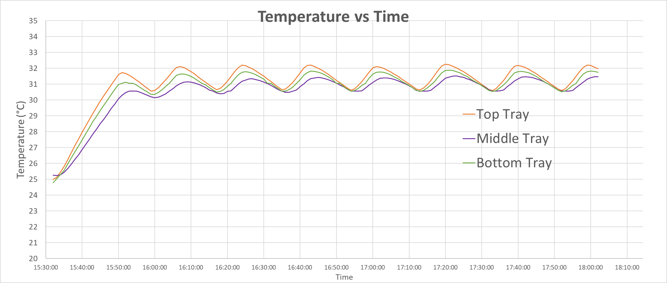
Testing Results
Temperature from 25°C (ambient) to 32°C in approximately 20 minutes
~0.5°C difference between each tray, based on air flow clearance inside
Dsf
Adasd
Asdads
asdad

Slide 8
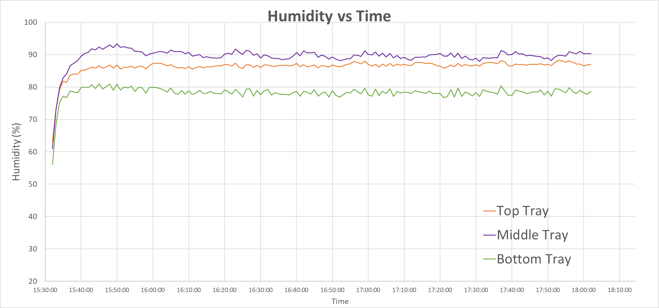
Testing Results
Humidity from 50-60% RH (ambient) to 80-90%RH in approximately 10 minutes
~10%RH variance between the top and bottom tray, based on air flow clearance inside

Slide 9
Budget
Current and future spending estimates
Approximately 25% of the Fermentabot Project budget has been spent developing a fully functioning prototype
Next steps include
Software and hardware development
Creating, fabricating, and testing a circuit board
Creating an online user interface that can control the Fermentabot and collect data via wi-fi
Fabricating two more Fermentabot units for Basque
TOTAL PURCHASES: | $ 2,160.93
Hours Worked (Eugene) (approx. 4.75 full time weeks) | 187
TOTAL LABOR: | $ 5,610.00
TOTAL BUDGET SPENT ON FERMENTABOT: | $ 7,770.93

Slide 10
Thank You.

Slide 11
Notes:
New team members

